Slide 1
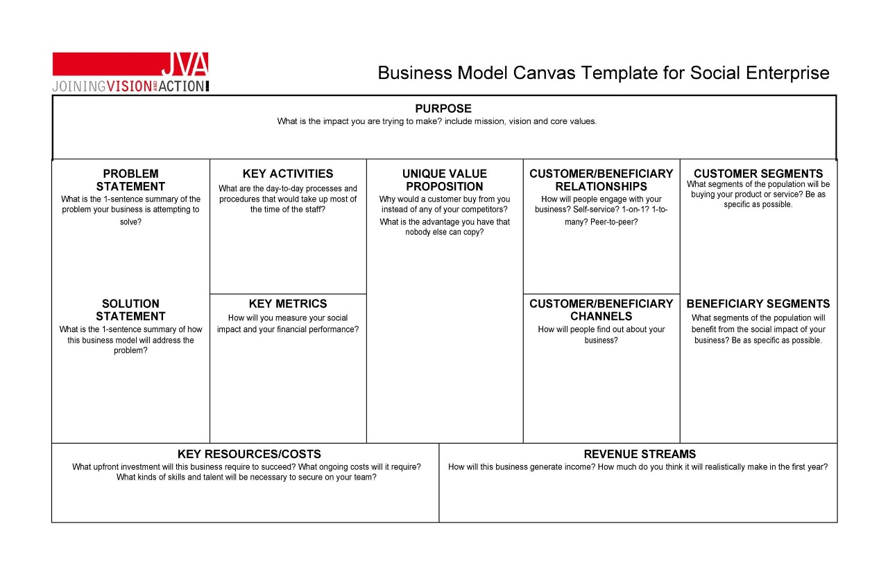
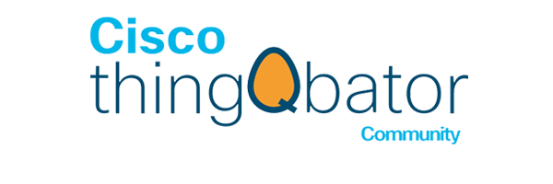
BUSINESS MODEL CANVAS FOR SMART WALKING STICK
PURPOSE
To enhance the mobility, safety, and independence of visually impaired individuals by providing a multifunctional smart walking stick equipped with advanced features like health monitoring, GPS tracking, fall detection, and obstacle detection.
To enhance the mobility, safety, and independence of visually impaired individuals by providing a multifunctional smart walking stick equipped with advanced features like health monitoring, GPS tracking, fall detection, and obstacle detection.
PROBLEM STATEMENT
KEY ACTIVITIES
UNIQUE VALUE PROPOSITION
CUSTOMER/BENEFICIARY RELATIONSHIPS
CUSTOMER SEGMENTS
Designing, developing, testing, and manufacturing the smart walking stick, along with providing customer support and raising awareness about its benefits.
Includes visually impaired individuals, their families and caretakers and healthcare providers.
Visually impaired and elderly individuals face challenges in mobility, safety, and health monitoring which do not allow caretakers in real-life support.
A smart, multifunctional walking stick that combines mobility, health monitoring, and safety in one device :
Real-time GPS tracking with alerts to caretakers.
1.Personalized Support: Dedicated helplines for maintenance.
2.Proactive Communication: Regular updates and notifications for user/caretakers .
KEY METRICS
CUSTOMER/BENEFICIARY
CHANNELS
BENEFICIARY SEGMENTS
SOLUTION STATEMENT
Visually impaired individuals across all age groups.
Families and caretakers concerned about mobility and safety .
Disability-focused organizations and healthcare providers.
Key metrics include
fall detection accuracy
GPS tracking efficiency
health monitoring usage
obstacle detection reliability
customer satisfaction
adoption rates
overall system performance.
Smart walking stick that empowers visually impaired individuals by providing safety, independence, and connectivity, while offering caretakers peace of mind through real-time monitoring and alerts.
People will discover this product through online platforms, social media campaigns, collaborations with healthcare providers and NGOs, and visibility at
assistive technology events.
KEY RESOURCES/COSTS
REVENUE STREAMS
Advanced sensors, microcontrollers, GPS modules, AI technology, skilled engineers, and partnerships with ThingQbator , with costs focused on research, development, manufacturing, and marketing.
1.Sales of smart walking sticks.
2. Subscription for advanced features and AI updates.
3. Service and maintenance packages.

